Slide 1
Use complex techniques to develop a digital media outcome Walter Savage

Slide 2
Step 1 : Empathize

Slide 3
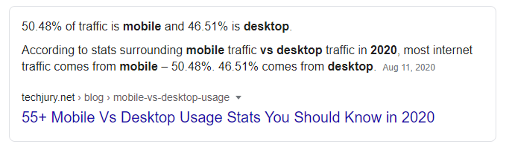
Task 1 : Identify your client and the purpose of your website, who is your target audience?
My Client is Myself. The purpose of my outcome is to give OBHS basketball a platform other than Facebook to update and inform fans and people of basketball in Dunedin and Nationally. My target audience is anywhere from primary school students to Grandparents so my website will have to cater for all needs. The most common screen width is mobile so my design will be optimized for mobile.

Slide 4
Accessibility
Accessibility is about how accessible the website is for every user.
To ensure that the accessibility is up to scratch I will ensure that the outcome can be viewed in many browsers and is able to be accessed across a range of devices.
I will also add alt tags to images to ensure people can grasp what the image is showing.
Notes:
Identify and explain 3 relevant implications that you will focus on during the creation of your project

Slide 5
Copyright
Copyright is to abide copyright laws and ensure we have permission to use the images and content on our website.
In my case I need to contact Brent Matahaere head of Basketball at OBHS to see if I can use the content from the Facebook page and use the OBHS Basketball Logo
Ill also need to contact Angela Ruske who takes photos of the OBHS basketball teams. I will use her photography in my website if granted permission.
Notes:
Identify and explain 3 relevant implications that you will focus on during the creation of your project

Slide 6
Aesthetics
Aesthetics is all about looks and how the website makes you feel. To ensure my website feels welcoming I will use the colours I’m given to make the page feel warm and welcoming using bright highlights and title colours. Also to make the website pleasing to look at I can limit the amount of white space and structure, so it is minimalistic and nice on the eyes.
Notes:
Identify and explain 3 relevant implications that you will focus on during the creation of your project

Slide 7
What are your client’s specifications?
The website must include four linked pages, the Home page, Team page, news page and a gallery page.
Colour scheme must follow those worn on the OBHS basketball uniform.
Includes link to the OBHS Basketball Facebook page in the header and footer.

Slide 8
Step 2 : Define

Slide 9
Website Structure
Website Site Map
index.html
team.html
news.html
gallery.html

Slide 10
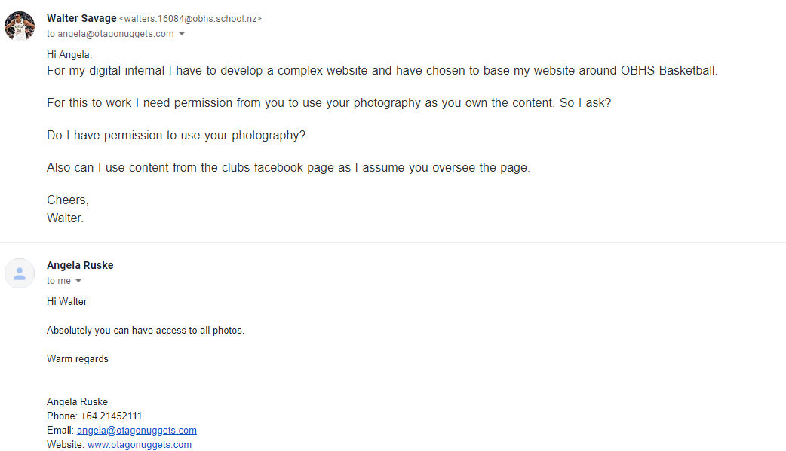
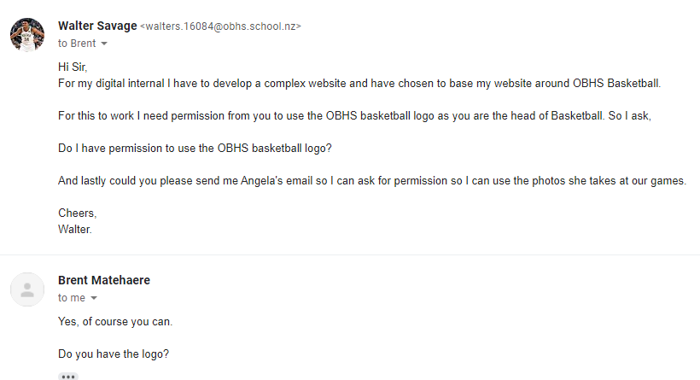
Evidence of written permission

Slide 11
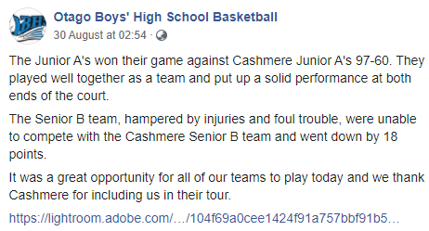
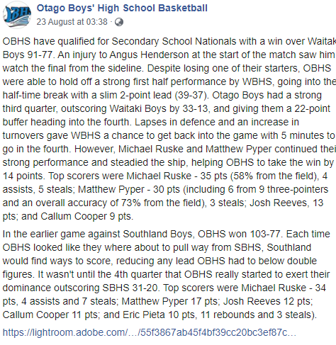
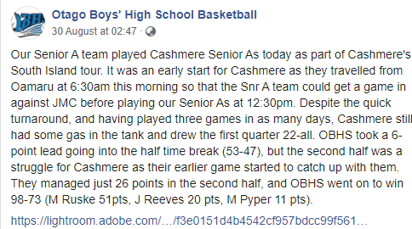
Data Integrity Gather content – proofread and edit
Notes:
Data integrity is ensuring the information displayed is up to date , spelled correctly . Do F7 on your word content.
Testing

Slide 12
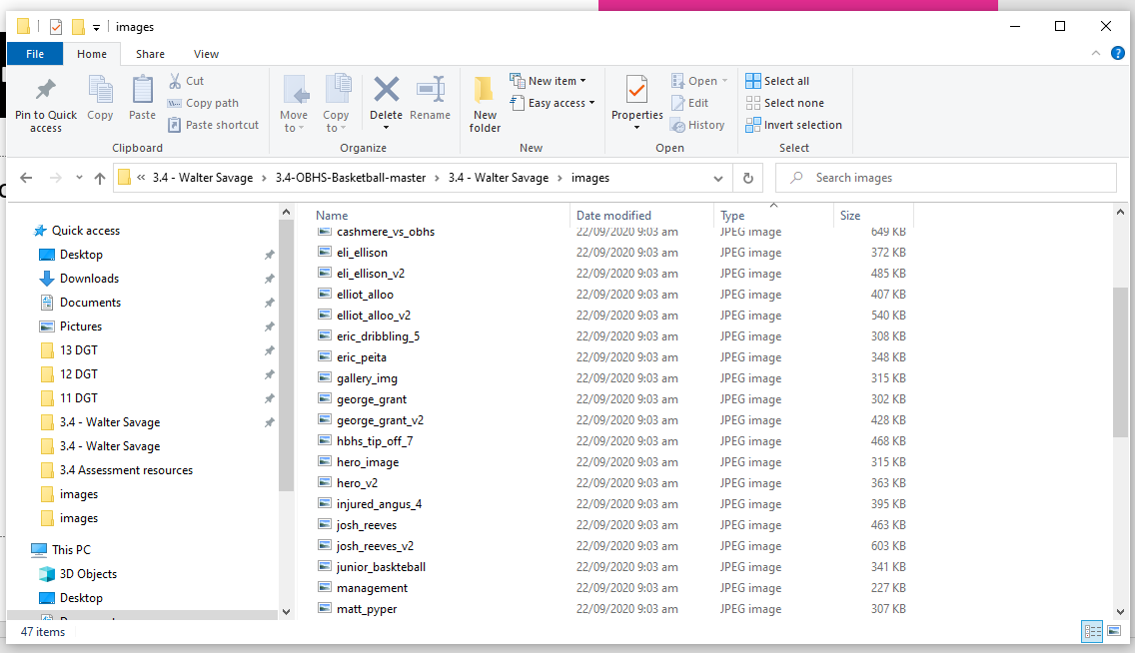
Gather Content
Notes:
Save images to an appropriate name folder
Compress / edit images where need be
Name the files accurately e.g home_mainimage.jpeg suzanne_collins_closeup.jpeg rather than 249784sflkjfnjksfxn3r8.jpeg
Record this process

Slide 13
Step 3 : Ideate

Slide 14
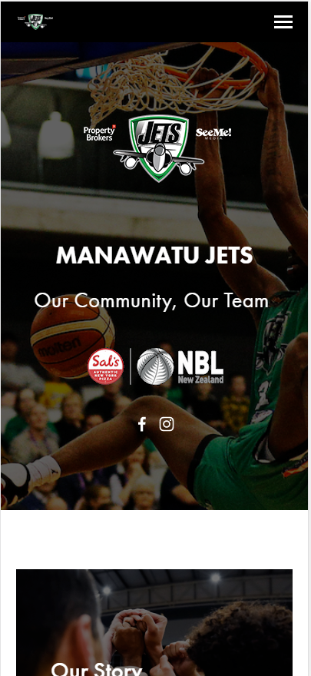
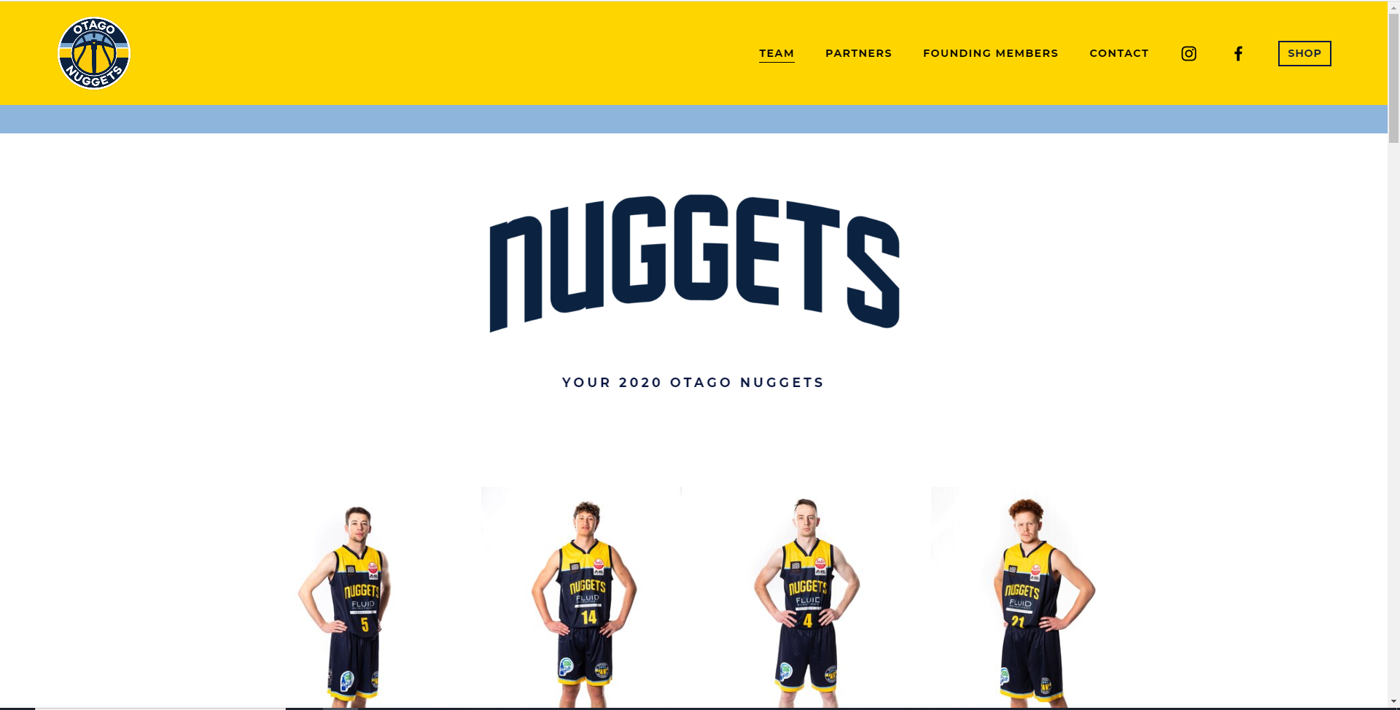
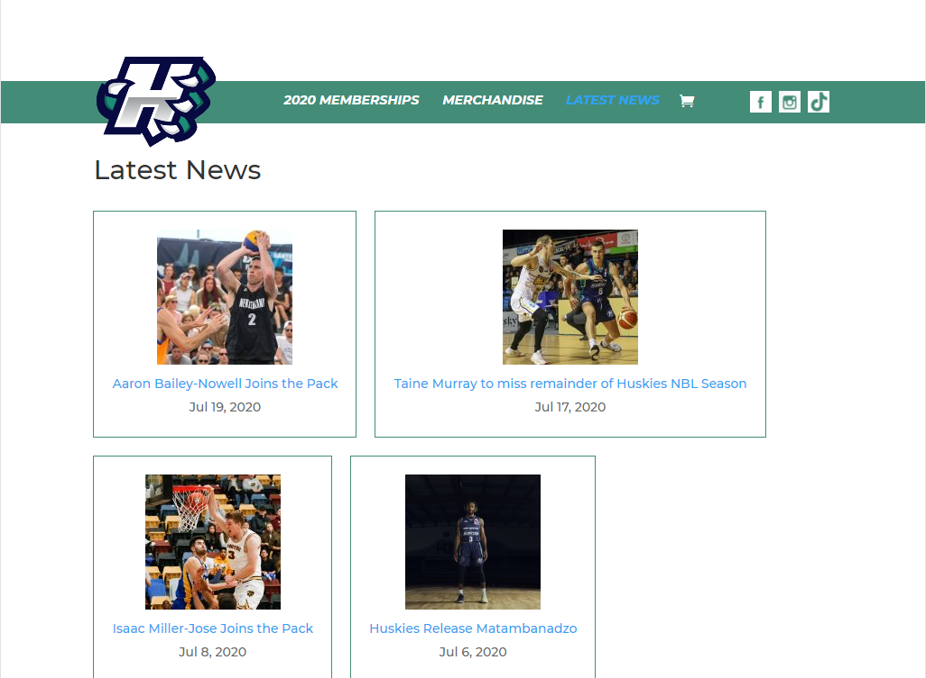
Trends

Slide 15
Trends
Looking at other NZ basketball club websites there are a lot of trends I would like to carry over.
One is when entering the home page they have a simple header with a large image with the team logo over laid, this looks very professional which I intend to carry over.
They also tend to incorporate secondary logos which I intend to created and incorporate into the design.

Slide 16
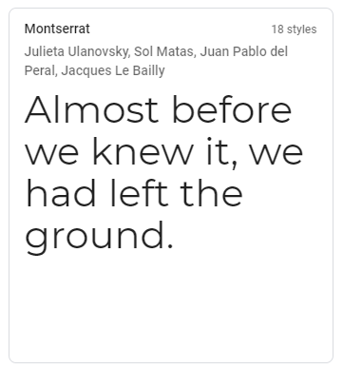
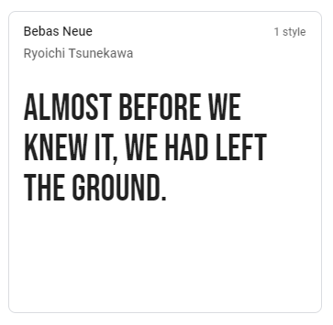
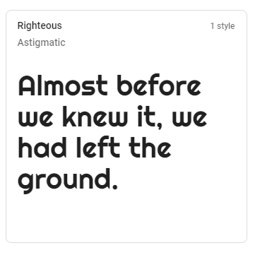
Font Combinations: Header
Vote: 1111
Vote: 1
Vote: 11

Slide 17
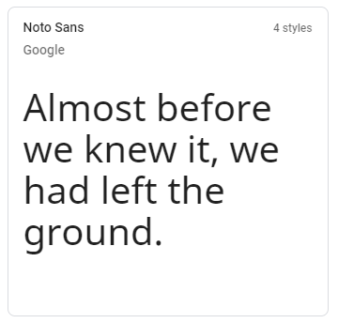
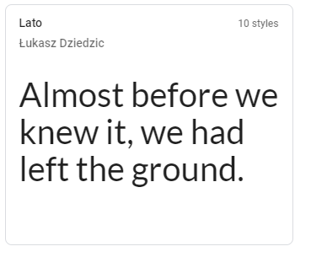
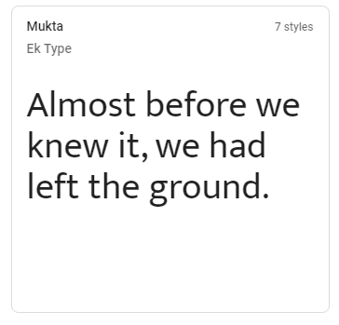
Font Combinations: Body
Vote: 11
Vote: 11
Vote: 1111

Slide 18
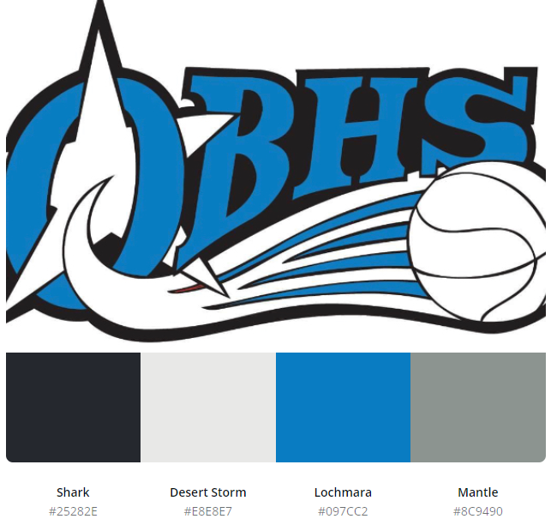

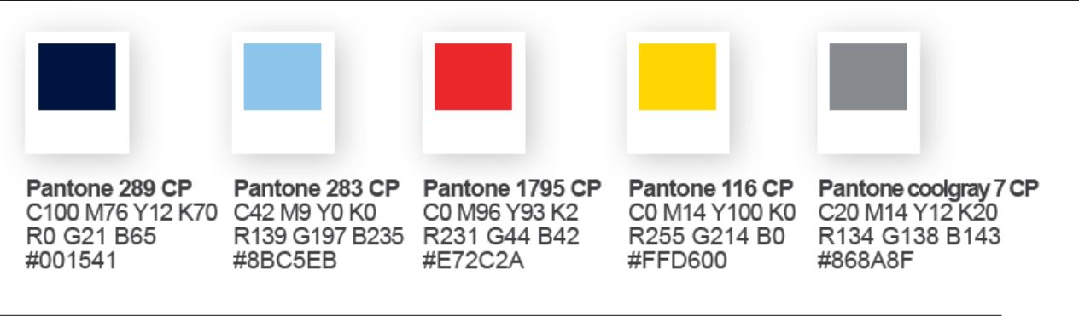
Vote: 11
Vote: 111111
Vote: 1

Slide 19
Low fidelity wireframes
Notes:
Use either

Slide 20
Step 4 : Protype/ Testing

Slide 21
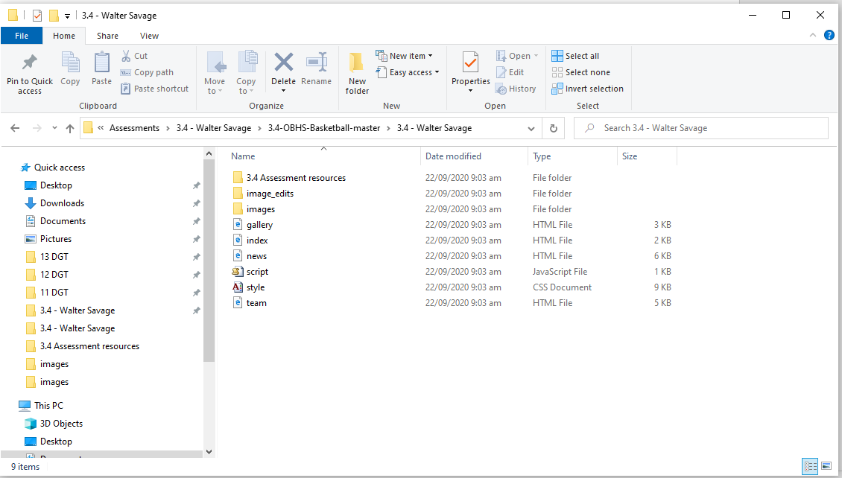
Site setup

Slide 22
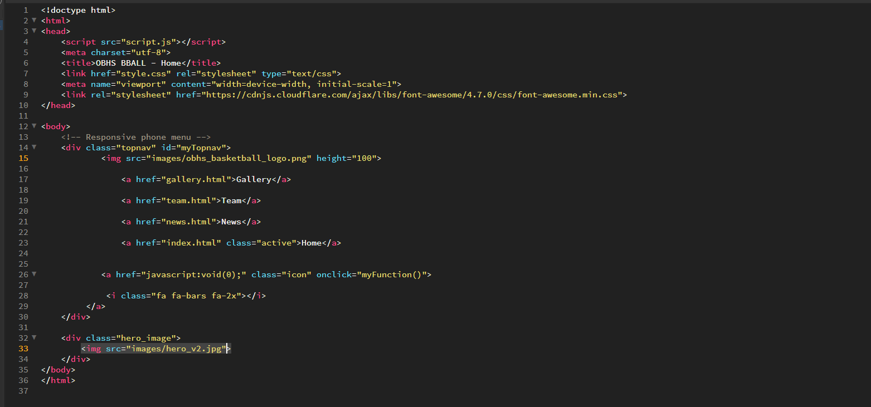
Index.html prototyping day 1

Slide 23
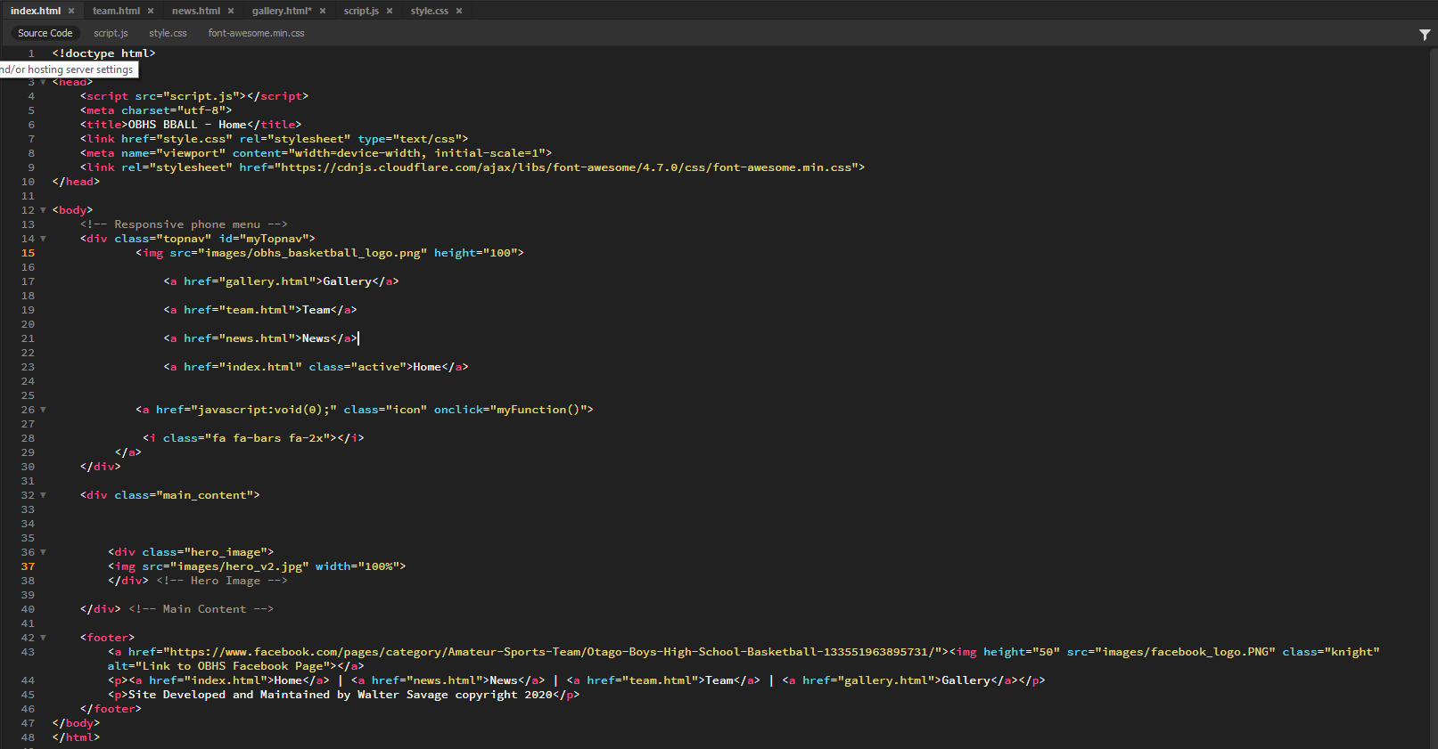
Index.html prototyping day 2

Slide 24
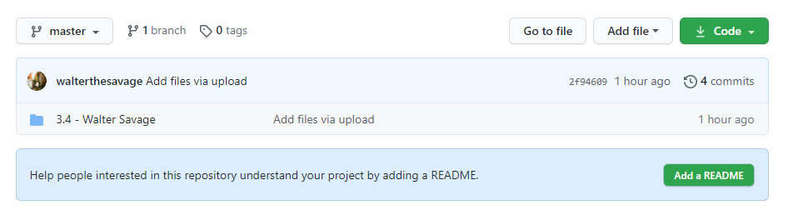
More version control on GITHUB
https://github.com/walterthesavage/3.4-OBHS-Basketball

Slide 25
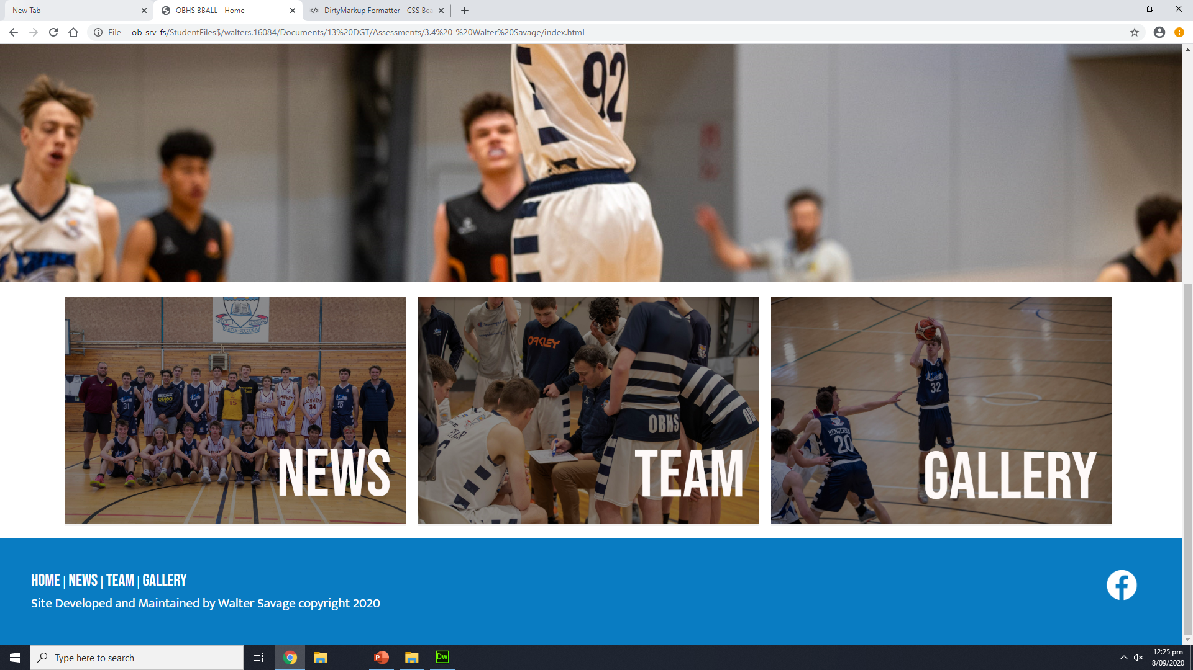
Day 4… Finished Index Page

Slide 26
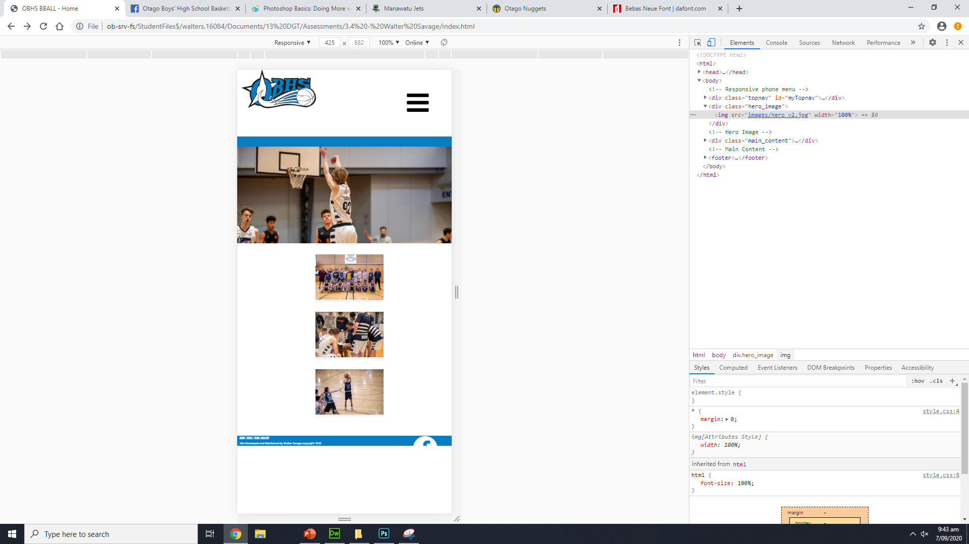
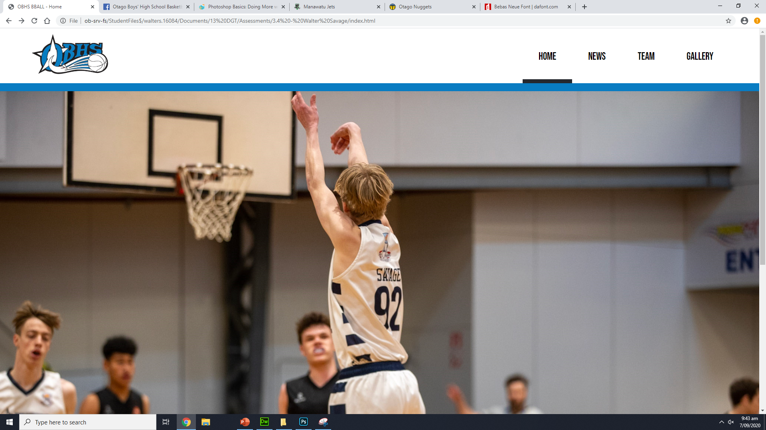
Feedback

Slide 27
Feedback
Nice use of colours the page scales down well also
The logo stays as a different size on phone view than the hamburger icon. It should be a little bit larger.

Slide 28
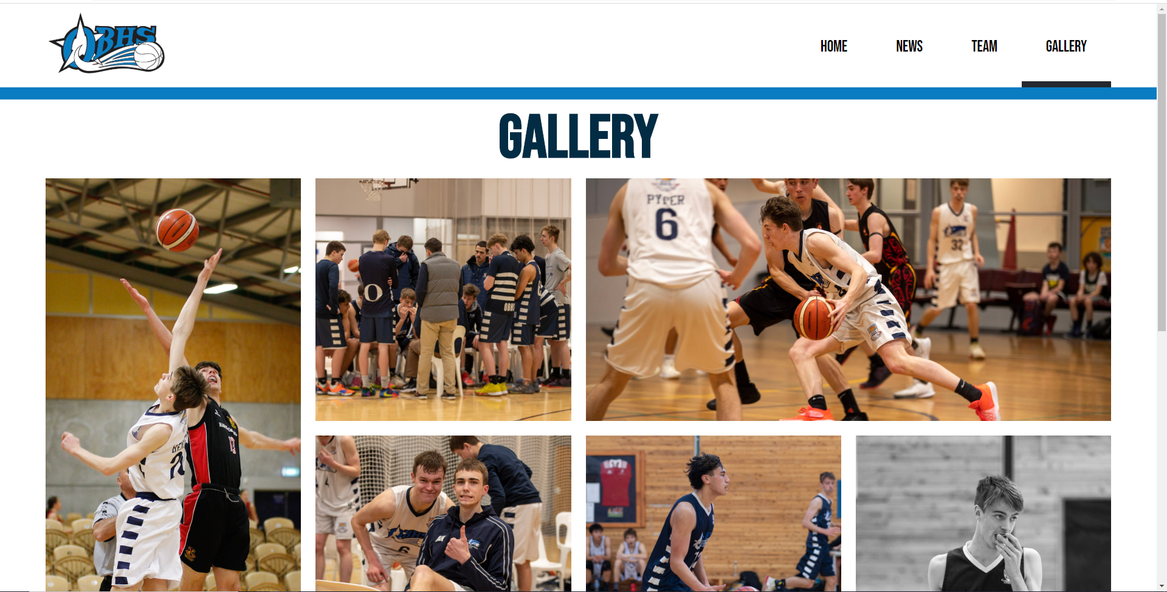
Feedback
Feedback
Make the rows even so the last row doesn’t just have 2 cards
Box shadow looks good
The Image layout is good
Maybe try having some sort of description on each image when you hover over it.

Slide 29
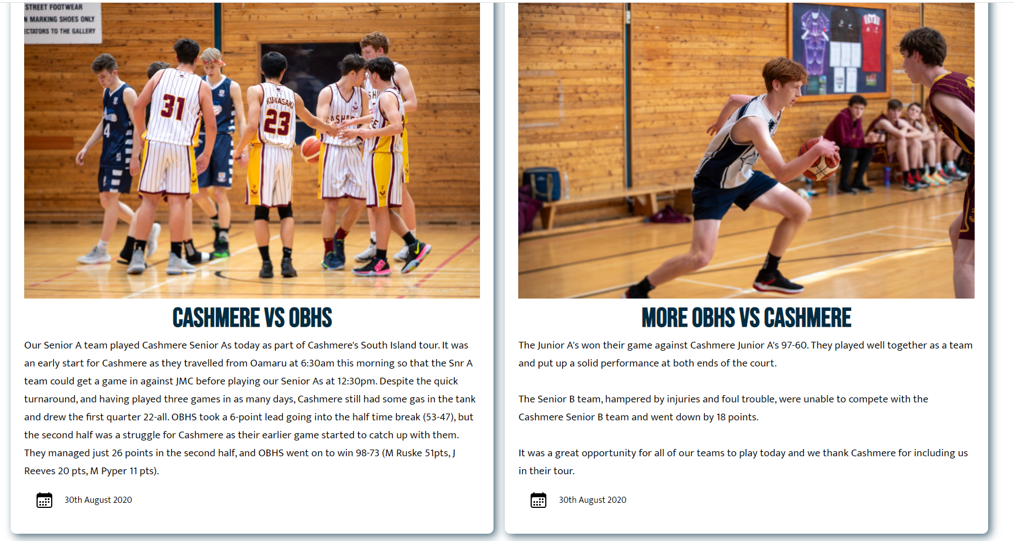
Feedback
Make the bottom two cards the same length so they align better
Remove the empty space at the bottom of the team page
When you click on an image there is no obvious way to close it again.

Slide 30
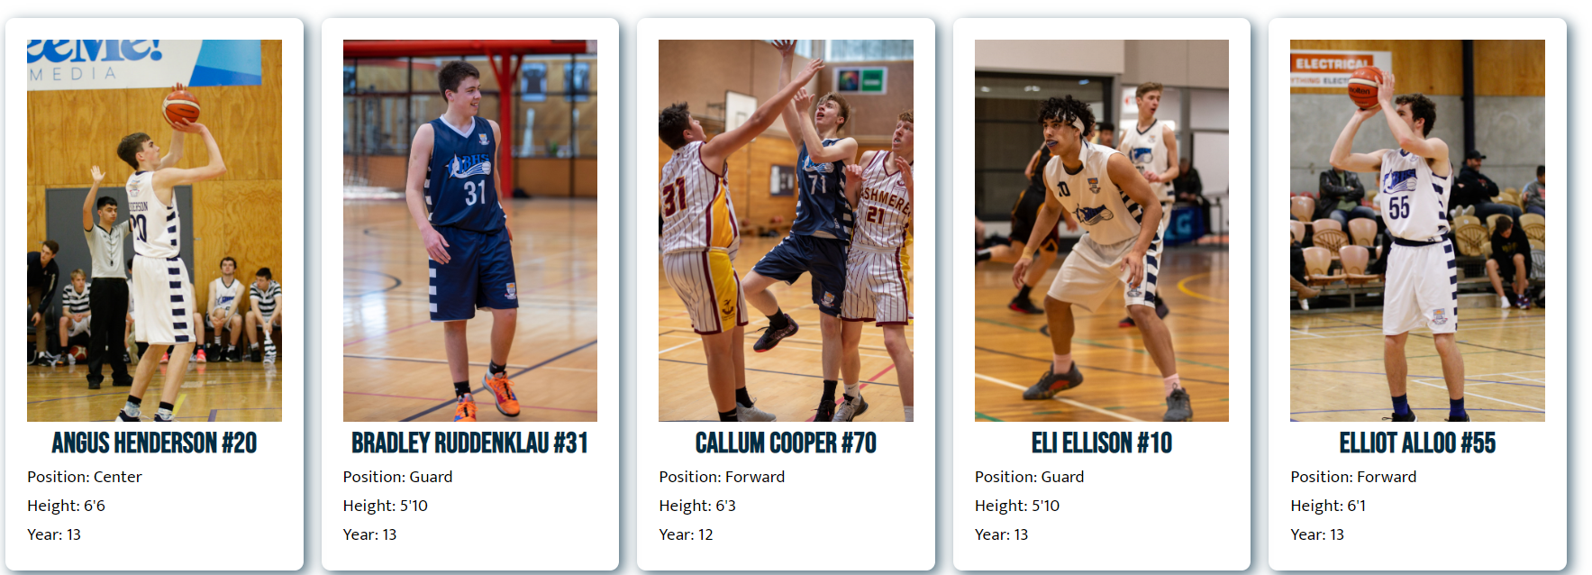
Feedback
Feedback: I really like how you have made the card big with the a nice full length picture

Slide 31
Feedback
Your gallery page is really nice with the way the pictures are laid out
Make the hamburger icon bigger so that its easier to click on mobile
Add some padding around the footer links so theyre better spaced

Slide 32
Evidence of iterative improvement

Slide 33
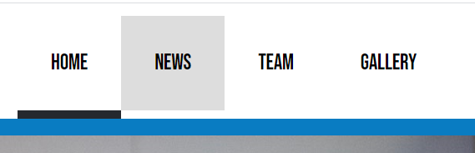
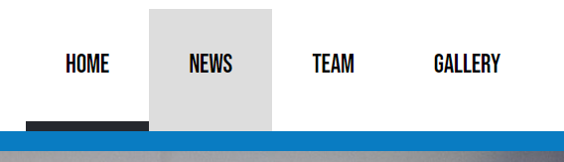
I added a border bottom on the hover to get rid of the white gap, this looks cleaner on the eye.
before
after

Slide 34
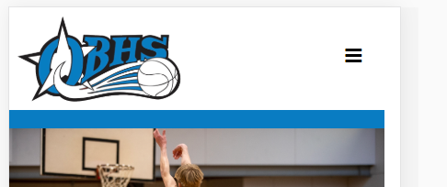
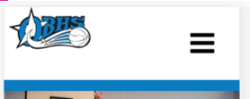
The website now scales down at every device width. The logo problem was fixed.

Slide 35


Added a new favicon that I created for the website. Adds personality and more recognition to the website.

Slide 36
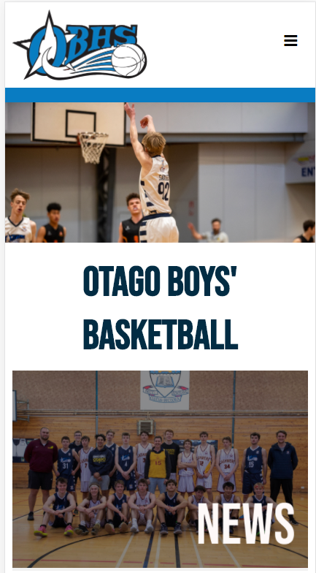

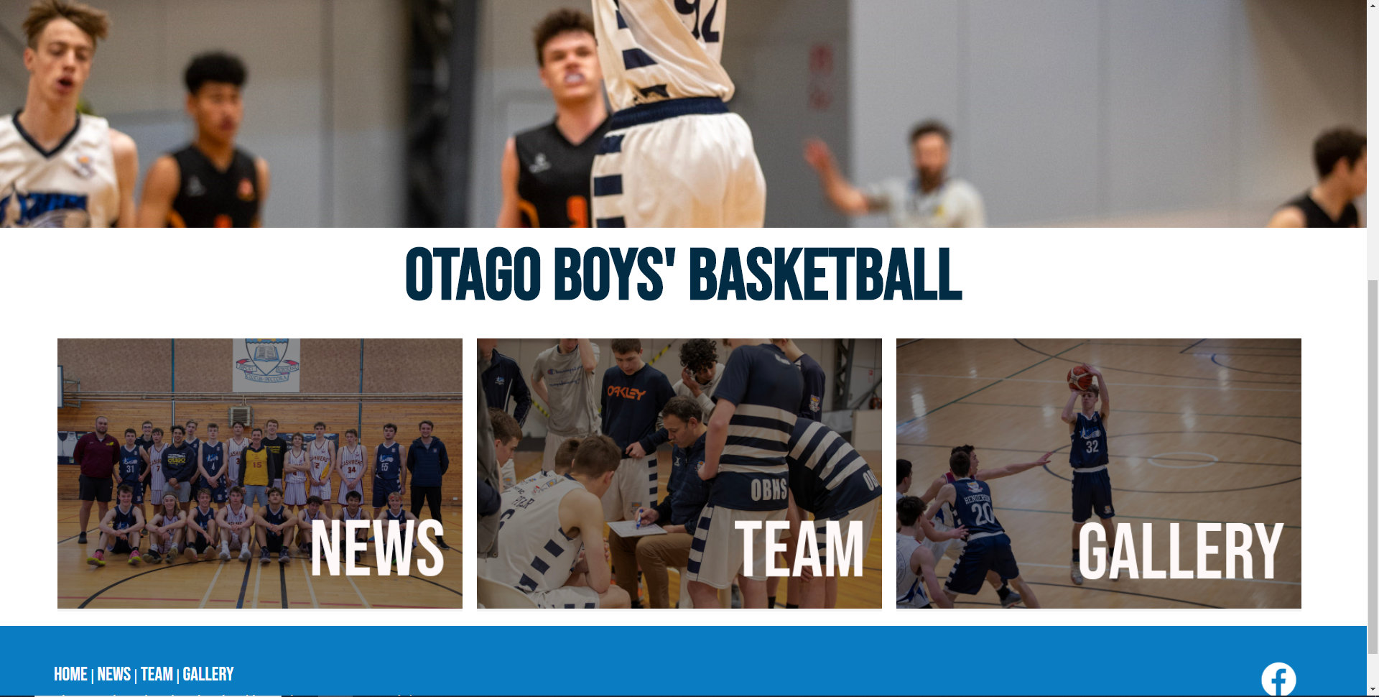
Testing Scaling: Phone vs Tablet vs Desktop
Notes:
Test your site on mobile, tablet and pc view

Slide 37
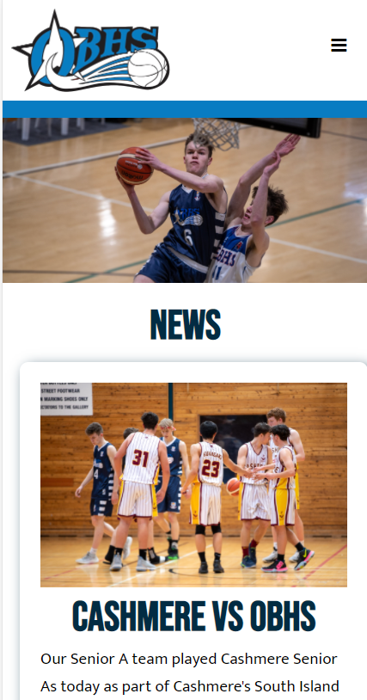
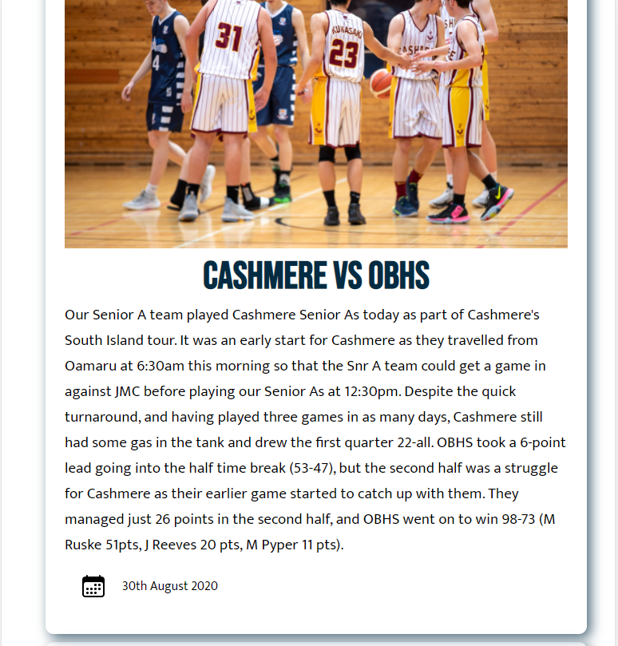
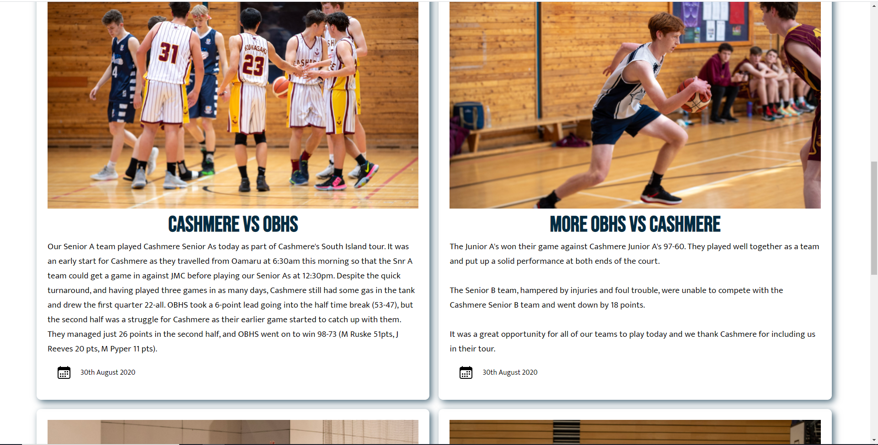
Testing Scaling: Phone vs Tablet vs Desktop
Notes:
Test your site on mobile, tablet and pc view

Slide 38
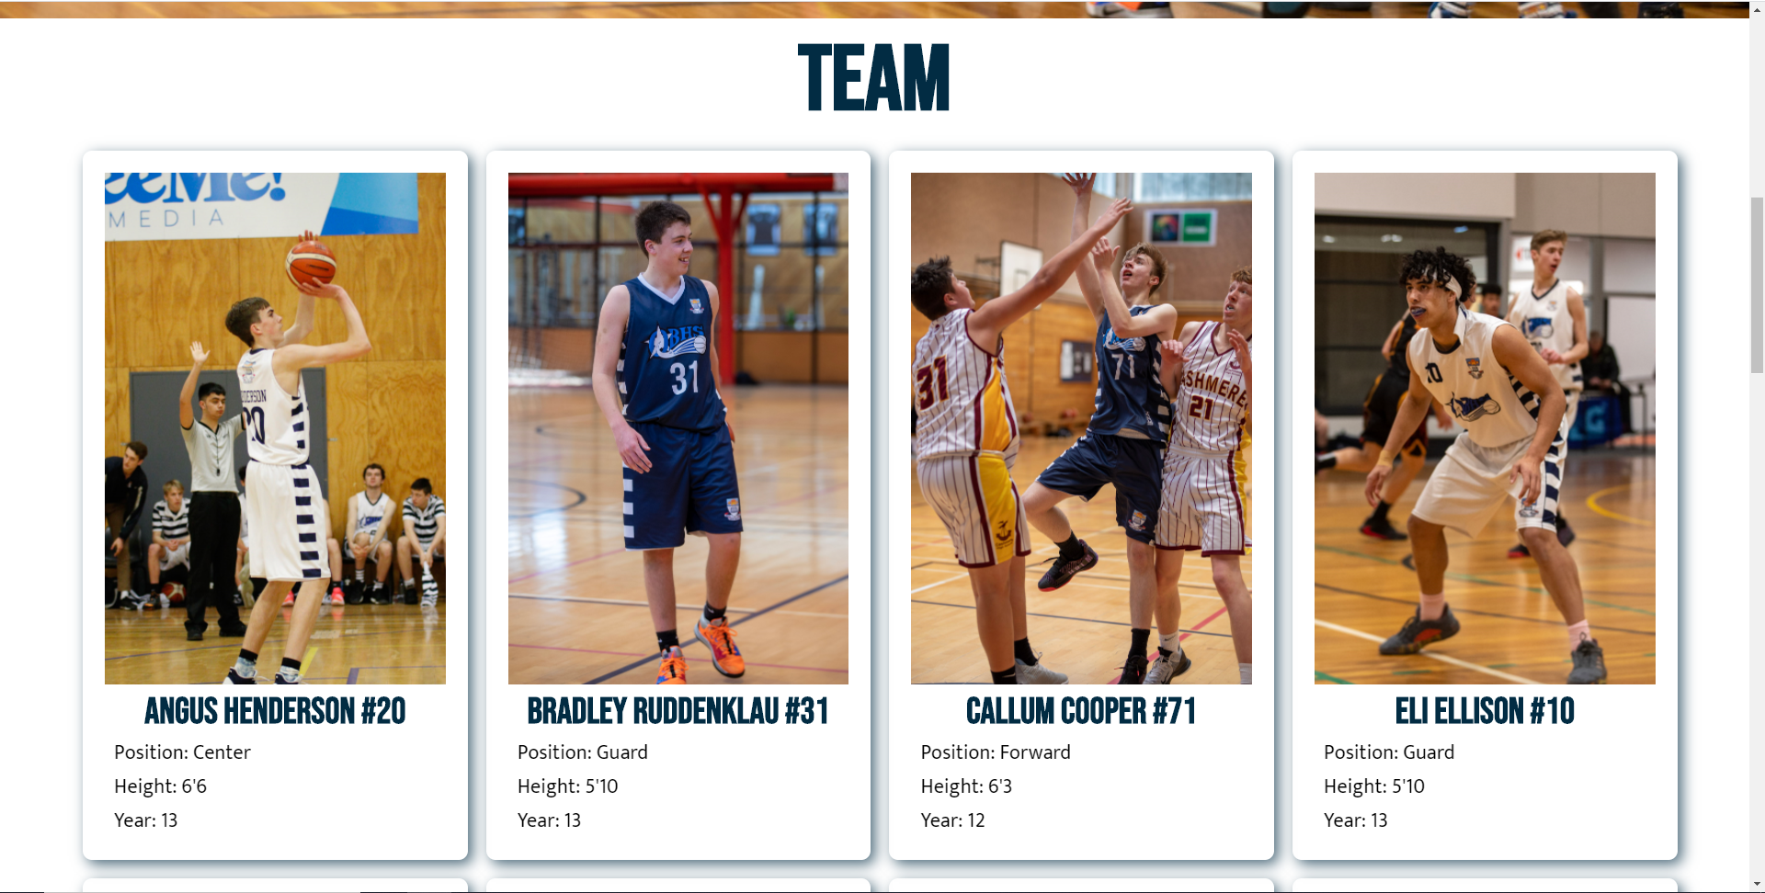
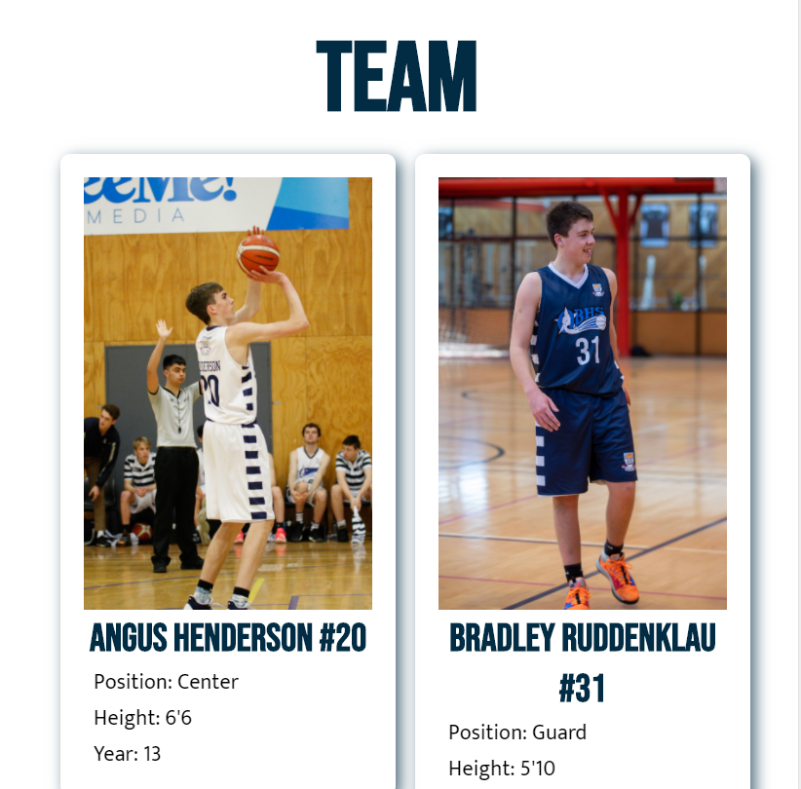
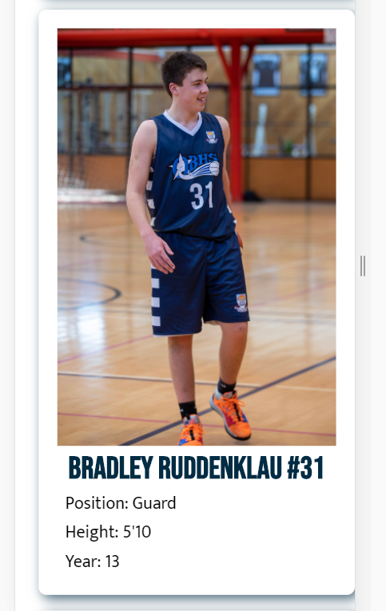
Testing Scaling: Phone vs Tablet vs Desktop
Notes:
Test your site on mobile, tablet and pc view

Slide 39
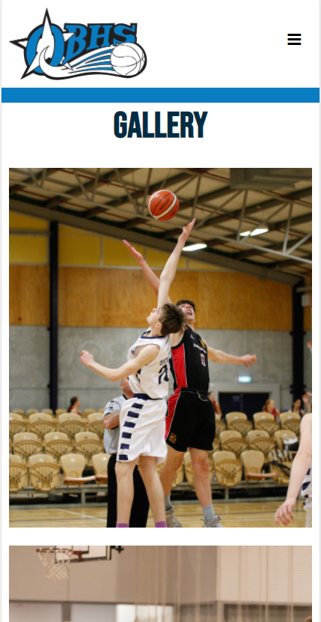
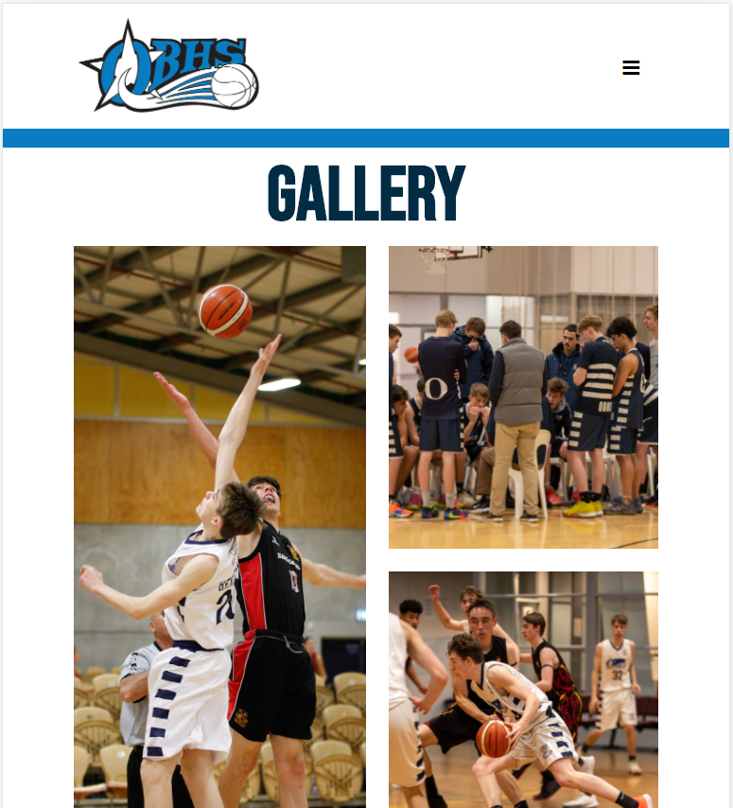
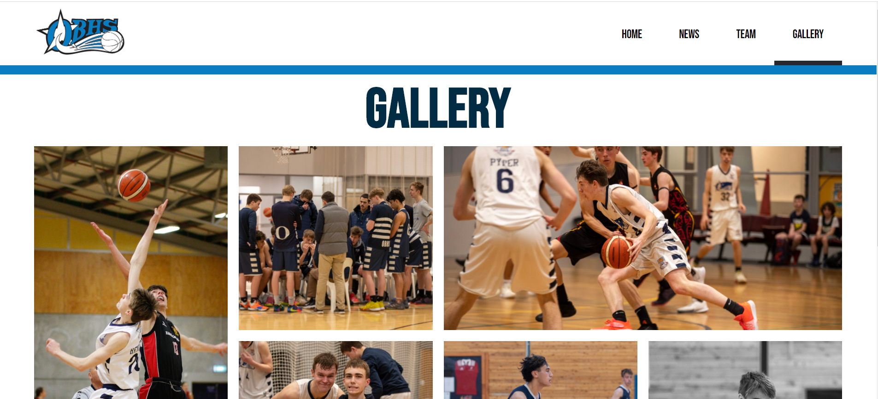
Testing Scaling: Phone vs Tablet vs Desktop
Notes:
Test your site on mobile, tablet and pc view

Slide 40
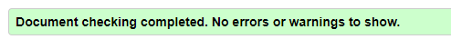
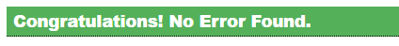
Testing Procedures: Validating the HTML/CSS
HTML Pages
Index.html, gallery.html, news.html, team.html
CSS Page
Style.css
Notes:
Validate your HTML/CSS3 website – screenshot the no errors.

Slide 41
Applying the UX (BASIC priniciples)to improve your design
Notes:
Identify which usability principles you have applied to improve the quality of your design – screenshot your design, place in your portfolio and annotate and explain how it improved the usability, aesthetics or functionality etc.

Slide 42
Explain how your final design addressed the relevant implications

Slide 43
Addressing relevant implication :

Slide 44
Addressing relevant implication :

Slide 45
Addressing relevant implication :

Slide 46
Final website
Notes:
Create a video of your site in desktop view, slowly going through the content, scale it down to phone view too,. Insert the video above

Slide 47
Final feedback from client

